Slide 1

Distributed Systems Lab 2
By: Michael Metry

Slide 2
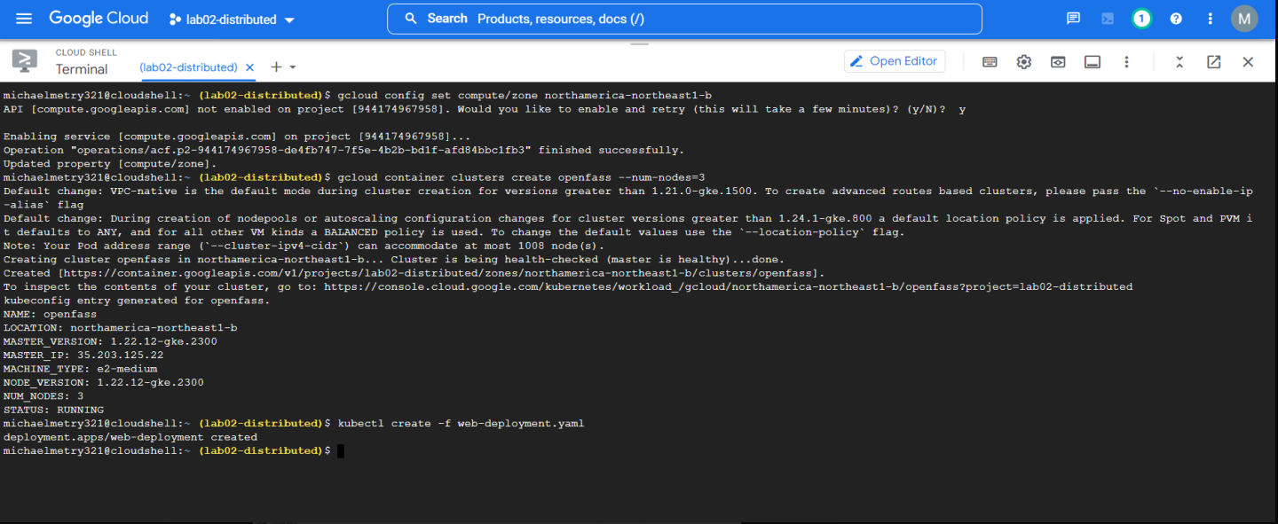

Slide 3

PART 2

Slide 4
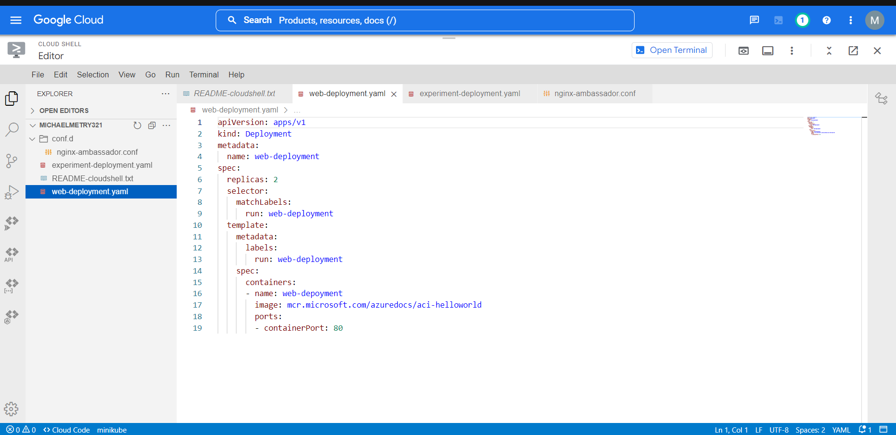
Web-Deployment Yaml File

Slide 5
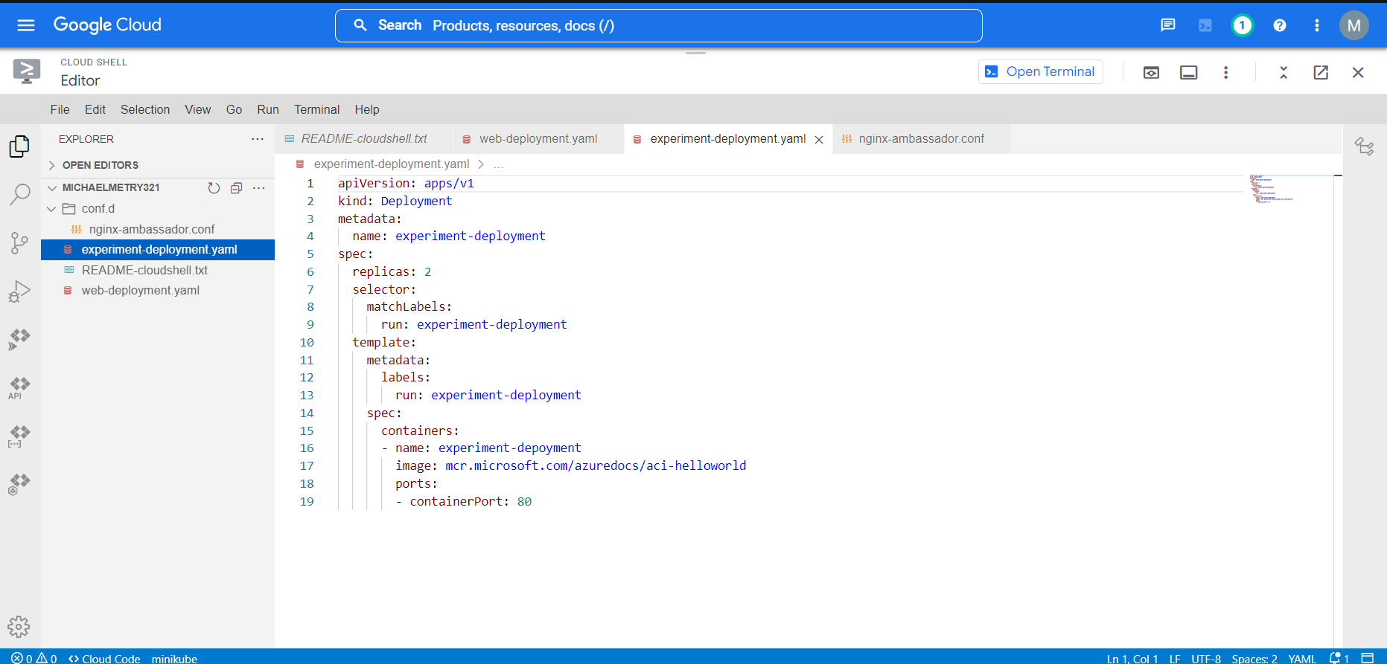
Experiment-Deployment Yaml File

Slide 6
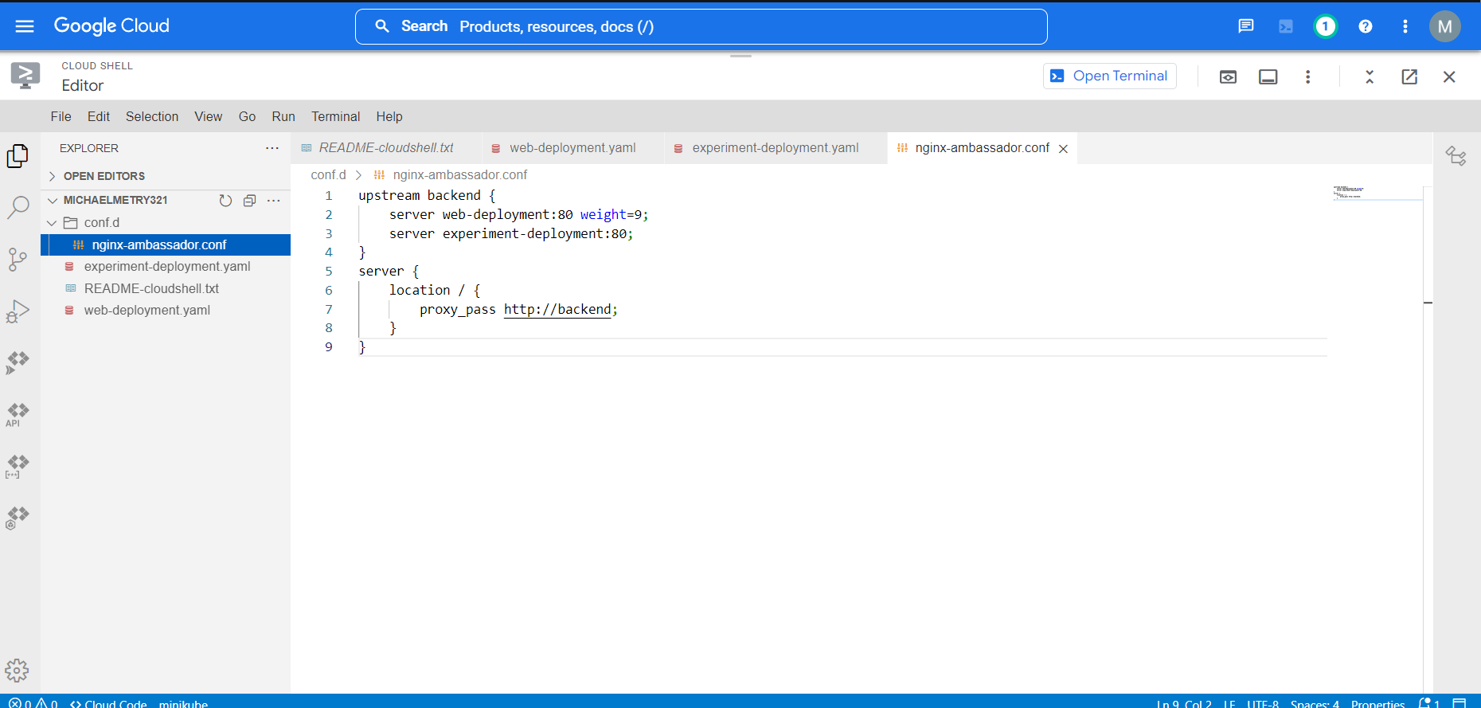
Nginx-ambassador. Conf File

Slide 7
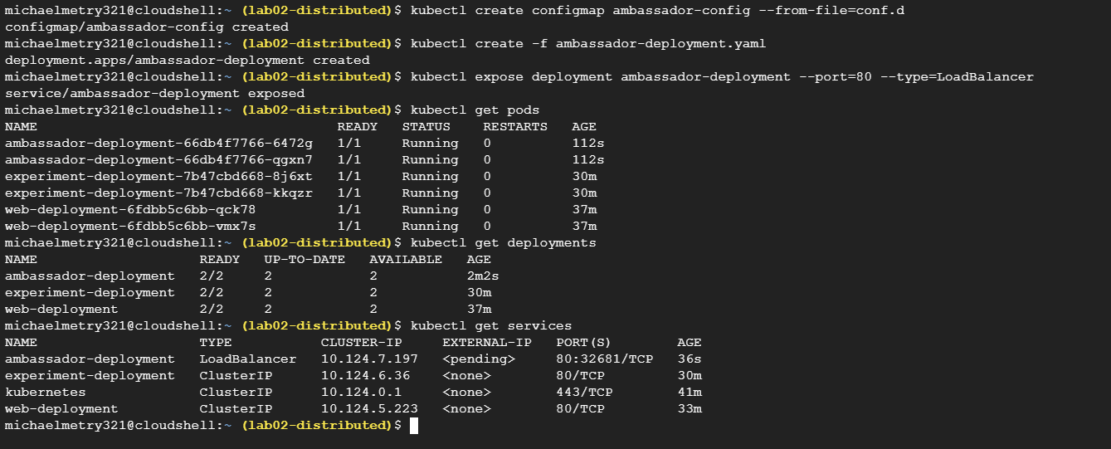

Slide 8
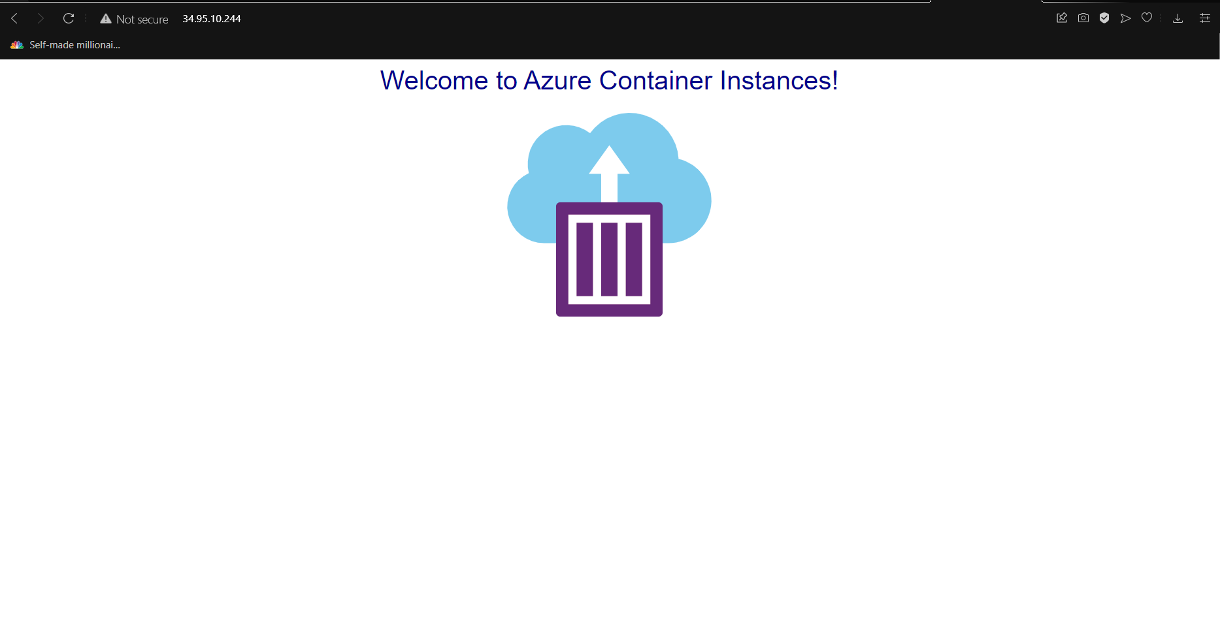

Slide 9
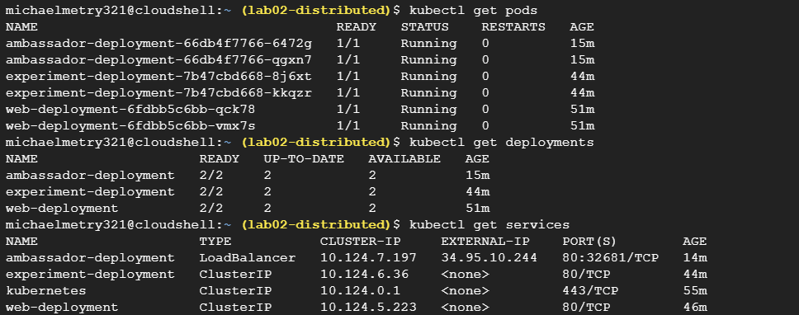

Slide 10
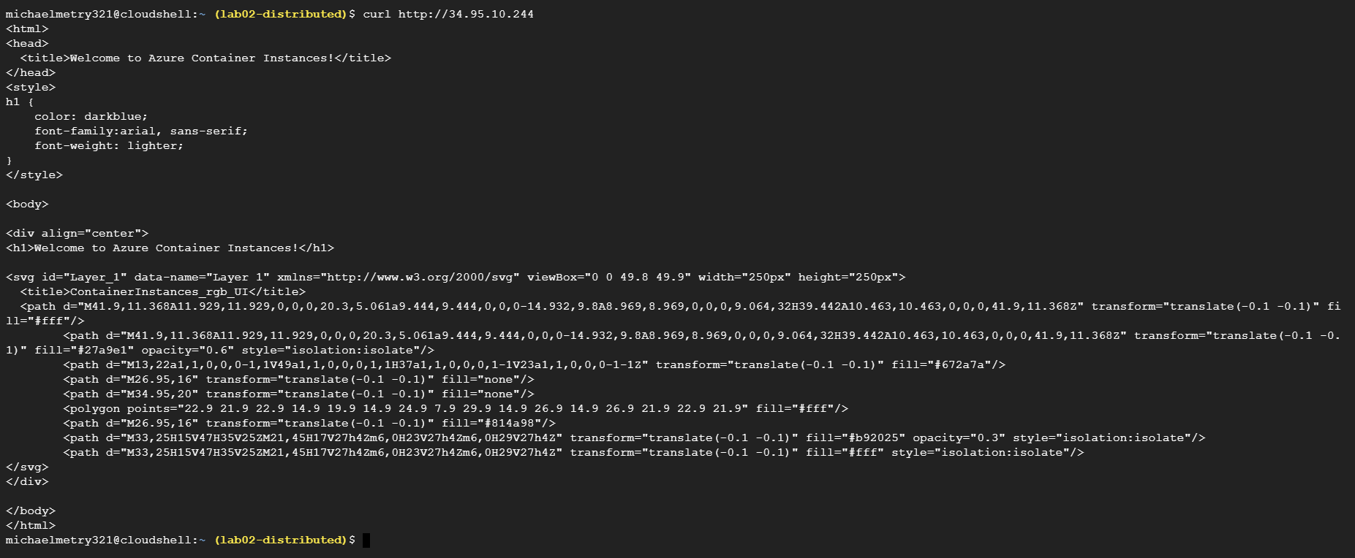


Slide 11


Part 3

Slide 12
